Slide 1
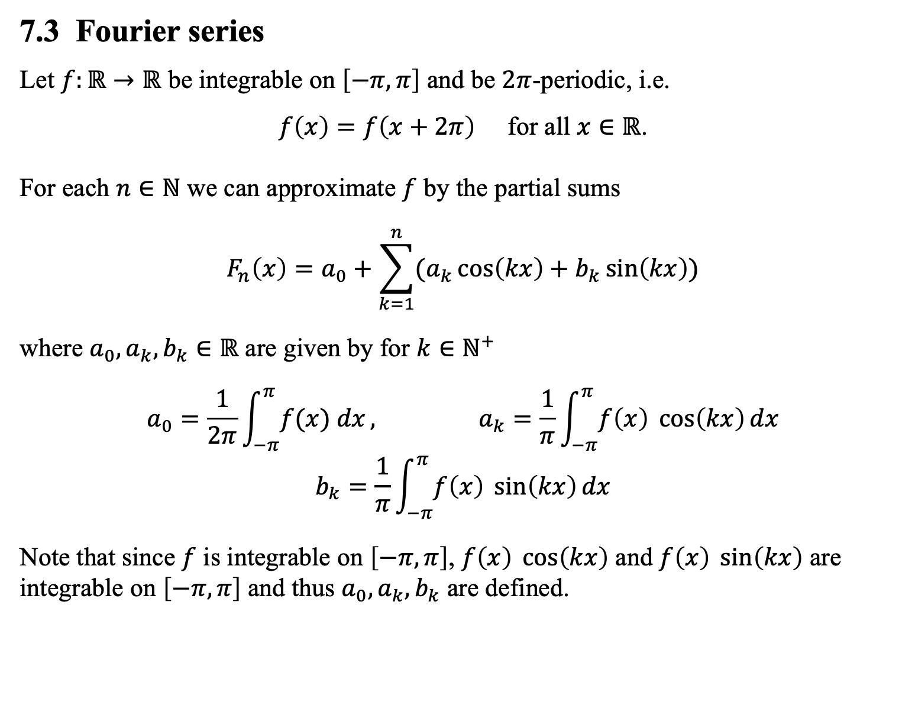
7.3 Fourier series
Let $f:ℝ→ℝ$ be integrable on $\left[−π,π\right]$ and be $2π$-periodic, i.e.
$f\left(x\right)=f\left(x+2π\right)$ for all $x∈ℝ$.
For each $n∈ℕ$ we can approximate $f$ by the partial sums
$$F_{n}\left(x\right)=a_{0}+\sum_{k=1}^{n}{(a_{k}\cos\left(kx\right)+b_{k}\sin\left(kx\right))}$$
where $a_{0},a_{k},b_{k}∈ℝ$ are given by for $k∈ℕ^{+}$
$$a_{0}=\frac{1}{2π}\int_{−π}^{π}{f(x) dx}, a_{k}=\frac{1}{π}\int_{−π}^{π}{f\left(x\right) \cos\left(kx\right)dx}$$
$$b_{k}=\frac{1}{π}\int_{−π}^{π}{f\left(x\right) \sin\left(kx\right)dx}$$
Note that since $f$ is integrable on $\left[−π,π\right]$, $f\left(x\right) \cos\left(kx\right)$ and $f\left(x\right) \sin\left(kx\right)$ are integrable on $\left[−π,π\right]$ and thus $a_{0},a_{k},b_{k}$ are defined.

Slide 2
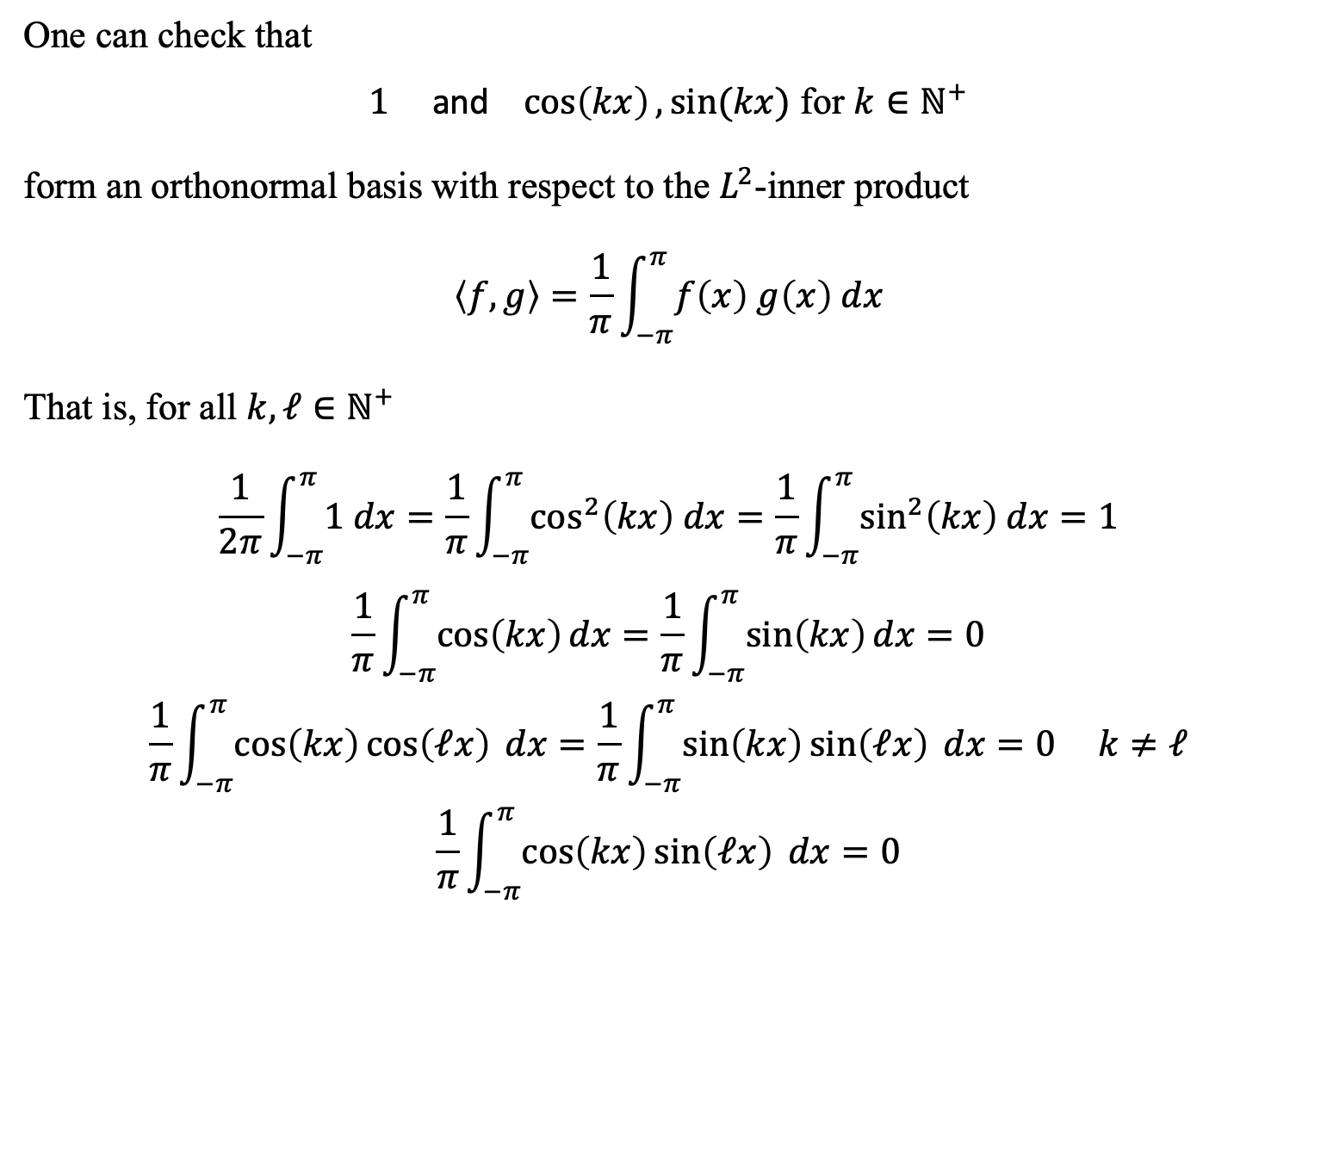
One can check that
$1$ and $\cos\left(kx\right), sin⁡(kx)$ for $k∈ℕ^{+}$
form an orthonormal basis with respect to the $L^{2}$-inner product
$$\left\langle f,g\right\rangle =\frac{1}{π}\int_{−π}^{π}{f\left(x\right) g\left(x\right) dx}$$
That is, for all $k,ℓ∈ℕ^{+}$
$$\frac{1}{2π}\int_{−π}^{π}{1 dx}=\frac{1}{π}\int_{−π}^{π}{\cos^{2}\left(kx\right) dx}=\frac{1}{π}\int_{−π}^{π}{\sin^{2}\left(kx\right) dx}=1$$
$$\frac{1}{π}\int_{−π}^{π}{\cos\left(kx\right)dx}=\frac{1}{π}\int_{−π}^{π}{\sin\left(kx\right)dx}=0$$
$$\frac{1}{π}\int_{−π}^{π}{\cos\left(kx\right)\cos\left(ℓx\right) dx}=\frac{1}{π}\int_{−π}^{π}{\sin\left(kx\right)\sin\left(ℓx\right) dx}=0 k≠ℓ$$
$$\frac{1}{π}\int_{−π}^{π}{\cos\left(kx\right)\sin\left(ℓx\right) dx}=0$$

Slide 3
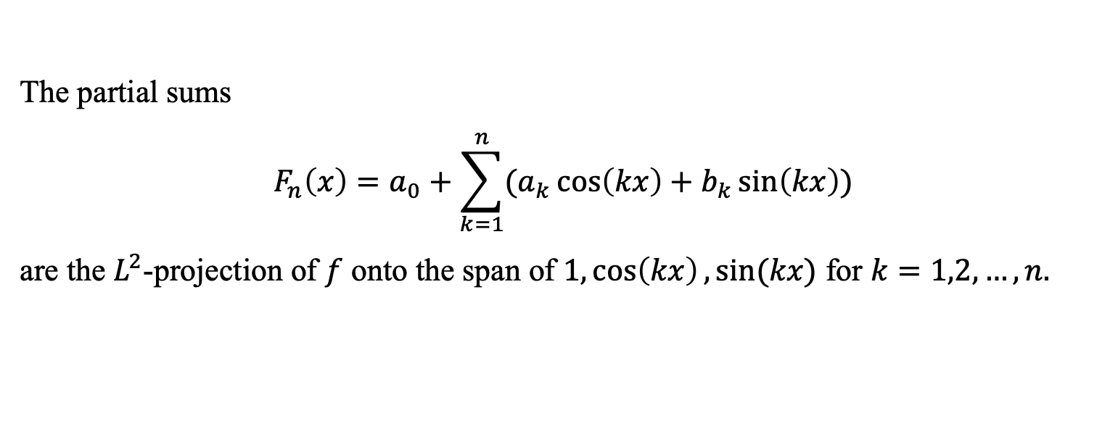
The partial sums
$$F_{n}\left(x\right)=a_{0}+\sum_{k=1}^{n}{(a_{k}\cos\left(kx\right)+b_{k}\sin\left(kx\right))}$$
are the $L^{2}$-projection of $f$ onto the span of $1,\cos\left(kx\right), sin⁡(kx)$ for $k=1,2,…,n.$

Slide 4
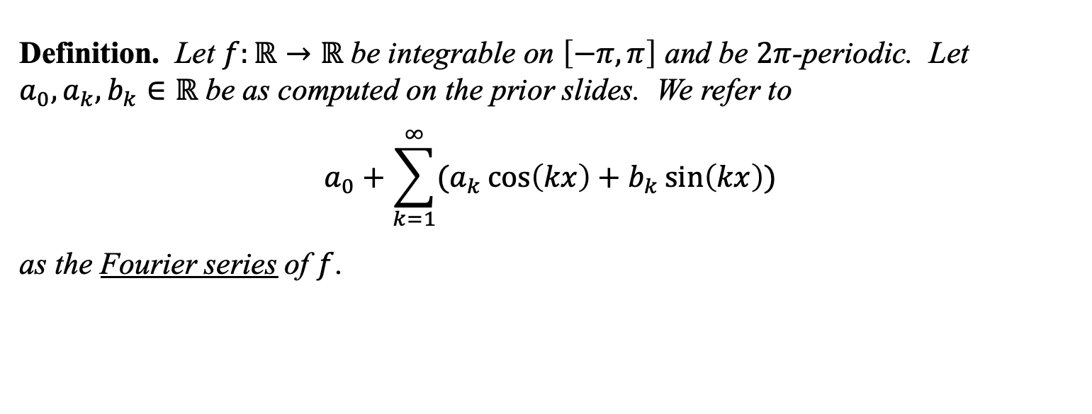
Definition. Let $f:ℝ→ℝ$ be integrable on $\left[−π,π\right]$ and be $2π$-periodic. Let $a_{0},a_{k},b_{k}∈ℝ$ be as computed on the prior slides. We refer to
$$a_{0}+\sum_{k=1}^{∞}{(a_{k}\cos\left(kx\right)+b_{k}\sin\left(kx\right))}$$
as the Fourier series of $f$.

Slide 5
Example. Let $f$ be the $2π$-periodic function given by $f\left(x\right)=x$ for all $x∈(−π,π]$. Find the Fourier series of the $f$.

Slide 6
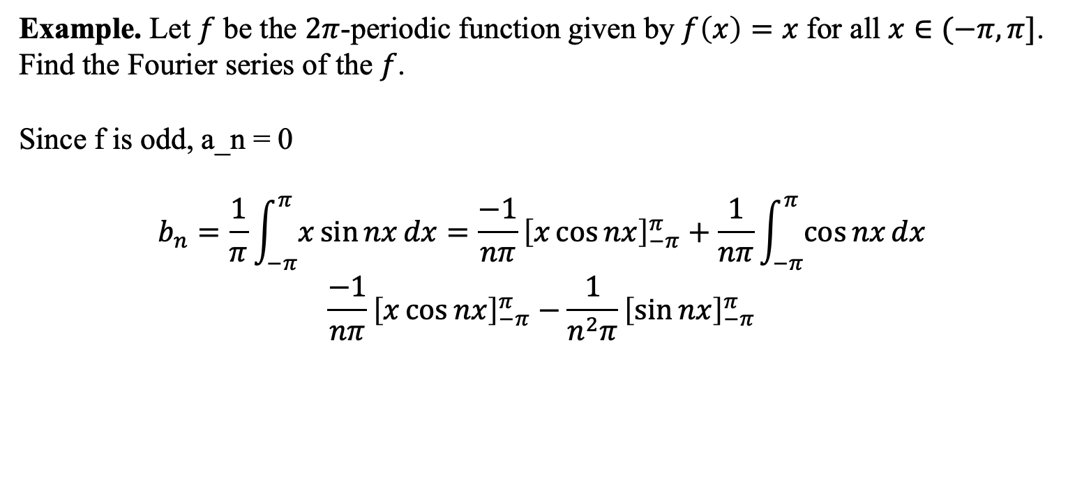
Example. Let $f$ be the $2π$-periodic function given by $f\left(x\right)=x$ for all $x∈(−π,π]$. Find the Fourier series of the $f$.
Since f is odd, a_n = 0
$$b_{n}=\frac{1}{π}\int_{−π}^{π}{x\sin{nx}dx}=\frac{−1}{nπ}{\left[x\cos{nx}\right]}_{−π}^{π}+\frac{1}{nπ}\int_{−π}^{π}{\cos{nx}dx}$$
$$\frac{−1}{nπ}{\left[x\cos{nx}\right]}_{−π}^{π}−\frac{1}{n^{2}π}{\left[\sin{nx}\right]}_{−π}^{π}$$

Slide 7
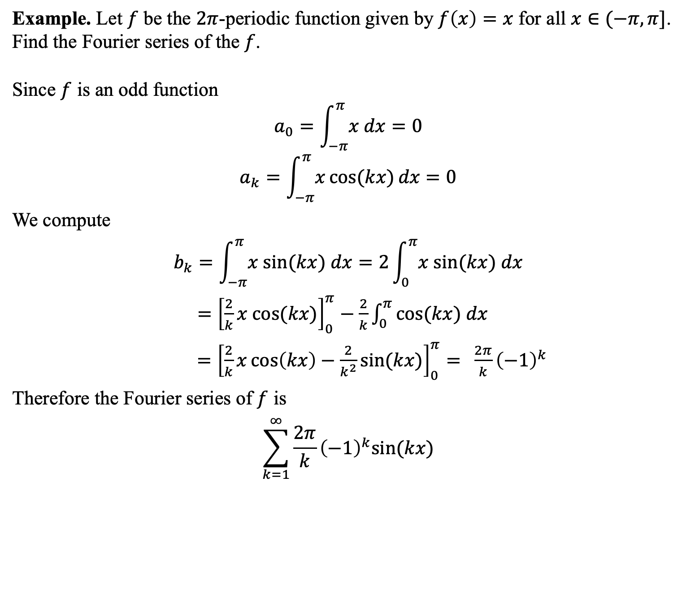
Example. Let $f$ be the $2π$-periodic function given by $f\left(x\right)=x$ for all $x∈(−π,π]$. Find the Fourier series of the $f$.
Since $f$ is an odd function
$$a_{0}=\int_{−π}^{π}{x dx}=0$$
$$a_{k}=\int_{−π}^{π}{x\cos{(kx)}dx}=0$$
We compute
$$b_{k}=\int_{−π}^{π}{x sin⁡(kx) dx}=2\int_{0}^{π}{x sin⁡(kx) dx}$$
$={\left[\frac{2}{k}x cos⁡(kx)\right]}_{0}^{π}−\frac{2}{k}\int_{0}^{π}{cos⁡(kx) dx}$
$={\left[\frac{2}{k}x\cos\left(kx\right)−\frac{2}{k^{2}}\sin{(kx)}\right]}_{0}^{π}= \frac{2π}{k}{\left(−1\right)}^{k}$
Therefore the Fourier series of $f$ is
$$\sum_{k=1}^{∞}{\frac{2π}{k}{\left(−1\right)}^{k}sin⁡(kx)}$$

Slide 8
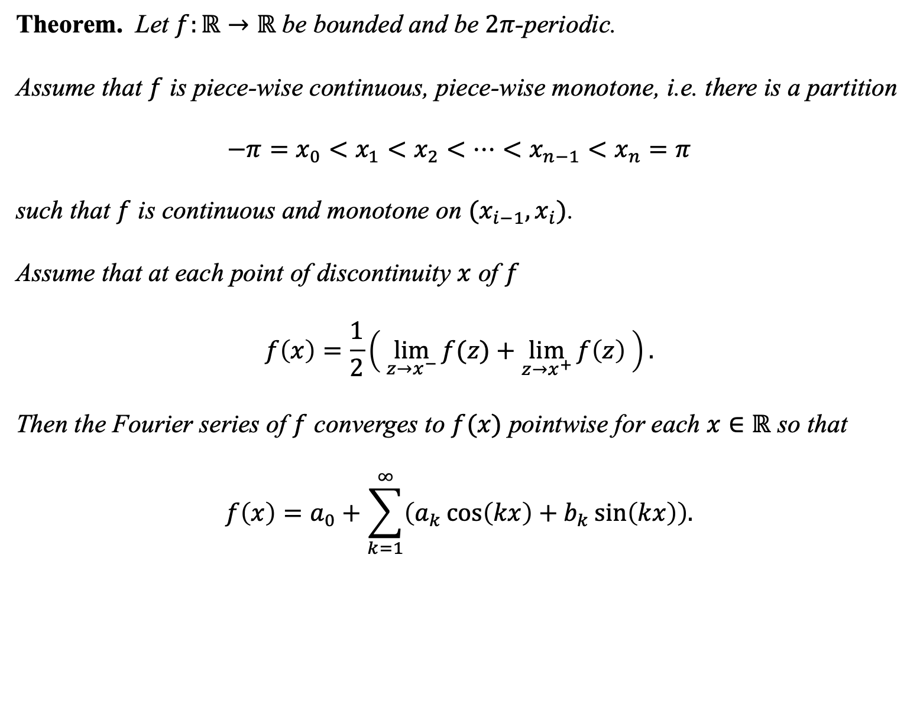
Theorem. Let $f:ℝ→ℝ$ be bounded and be $2π$-periodic.
Assume that $f$ is piece-wise continuous, piece-wise monotone, i.e. there is a partition
$$−π=x_{0}<x_{1}<x_{2}<⋯<x_{n−1}<x_{n}=π$$
such that $f$ is continuous and monotone on $(x_{i−1},x_{i})$.
Assume that at each point of discontinuity $x$ of $f$
$$f\left(x\right)=\frac{1}{2}\left( \lim_{z→x^{−}}{f(z)}+\lim_{z→x^{+}}{f\left(z\right) }\right).$$
Then the Fourier series of $f$ converges to $f(x)$ pointwise for each $x∈ℝ$ so that
$$f\left(x\right)=a_{0}+\sum_{k=1}^{∞}{\left(a_{k}\cos\left(kx\right)+b_{k}\sin\left(kx\right)\right).}$$

Slide 9

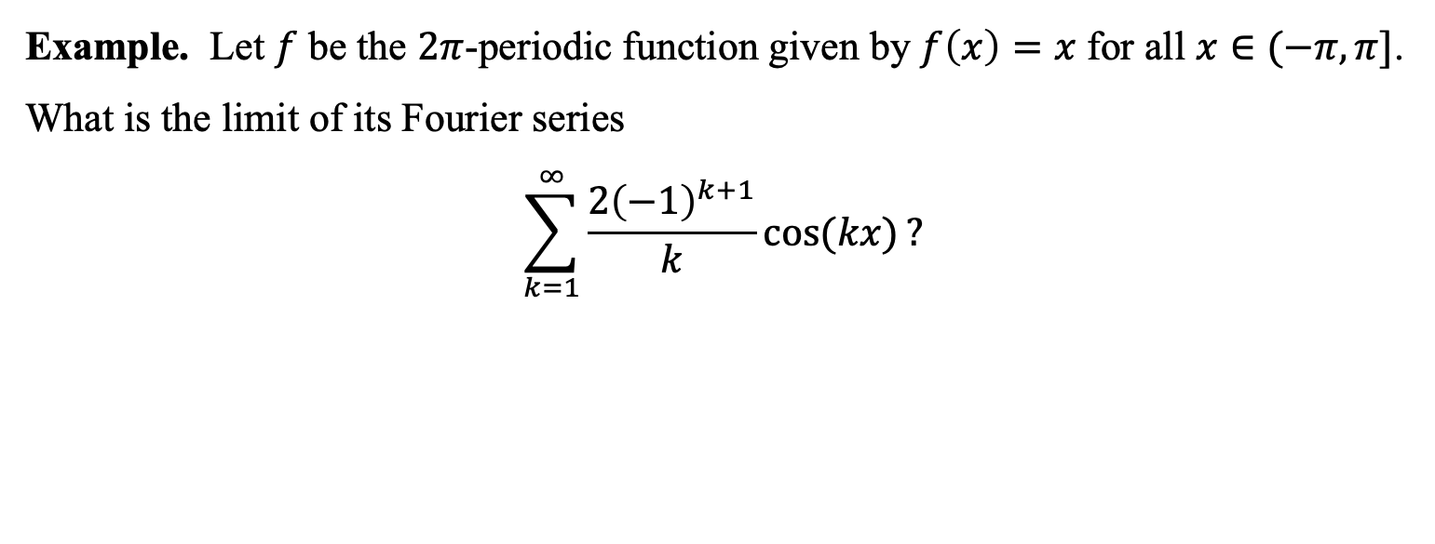
Example. Let $f$ be the $2π$-periodic function given by $f\left(x\right)=x$ for all $x∈(−π,π]$.
What is the limit of its Fourier series
$$\sum_{k=1}^{∞}{\frac{2{\left(−1\right)}^{k+1}}{k}cos⁡(kx)}?$$
$$x$$

Slide 10
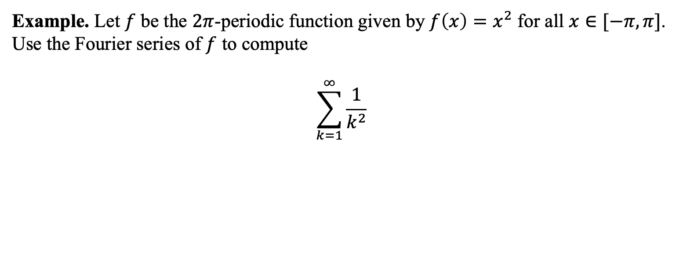
Example. Let $f$ be the $2π$-periodic function given by ${f\left(x\right)=x}^{2}$ for all $x∈[−π,π]$. Use the Fourier series of $f$ to compute
$$\sum_{k=1}^{∞}{\frac{1}{k^{2}}}$$
$$x$$

Slide 11
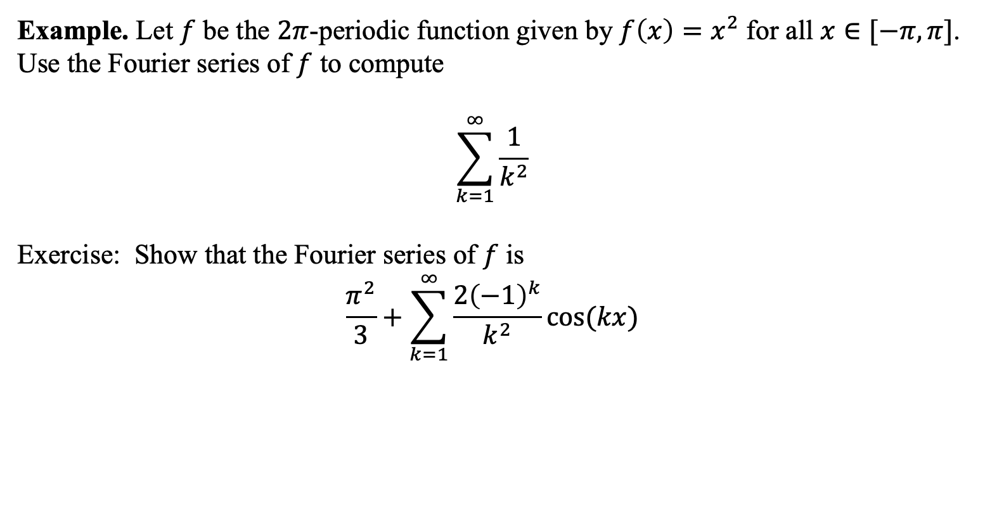
Example. Let $f$ be the $2π$-periodic function given by ${f\left(x\right)=x}^{2}$ for all $x∈[−π,π]$. Use the Fourier series of $f$ to compute
$$\sum_{k=1}^{∞}{\frac{1}{k^{2}}}$$
Exercise: Show that the Fourier series of $f$ is
$$\frac{π^{2}}{3}+\sum_{k=1}^{∞}{\frac{2{\left(−1\right)}^{k}}{k^{2}}cos⁡(kx)}$$
$$x$$

Slide 12
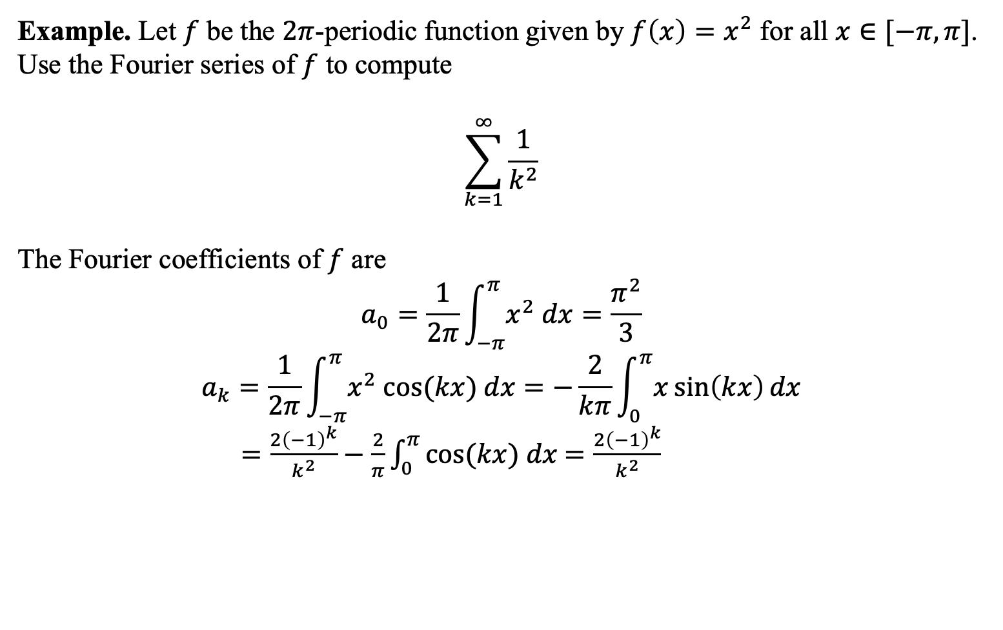
Example. Let $f$ be the $2π$-periodic function given by ${f\left(x\right)=x}^{2}$ for all $x∈[−π,π]$. Use the Fourier series of $f$ to compute
$$\sum_{k=1}^{∞}{\frac{1}{k^{2}}}$$
The Fourier coefficients of $f$ are
$$a_{0}=\frac{1}{2π}\int_{−π}^{π}{x^{2} dx}=\frac{π^{2}}{3}$$
$$a_{k}=\frac{1}{2π}\int_{−π}^{π}{x^{2} cos⁡(kx) dx}=−\frac{2}{kπ}\int_{0}^{π}{x\sin\left(kx\right)dx}$$
$=\frac{2{\left(−1\right)}^{k}}{k^{2}}−\frac{2}{π}\int_{0}^{π}{cos⁡(kx) dx}$ $=\frac{2{\left(−1\right)}^{k}}{k^{2}}$

